Slide 1
Secure Coding Guideline – EXP15-C
Do not place a ';' on the same line as an if, for, or while statement
Praneesh R V
CB.SC.U4CYS23036

Slide 2
Why This Rule Exists
In C, a semicolon (;) marks the end of a statement.
If you accidentally put ; after a control structure (if, for, while):
The condition executes as an empty statement.
The following block is not tied to the condition anymore.
These bugs:
Don’t cause compiler errors.
Look “normal” at a glance.
Can introduce subtle and dangerous vulnerabilities.

Slide 3
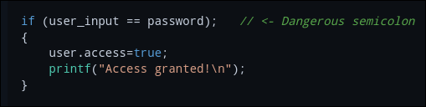
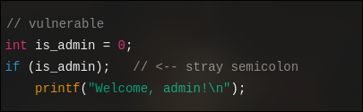
Problem Example – if statement
The if condition is checked, but the statement immediately ends due to a semicolon.
The subsequent code block executes unconditionally.
Impact:
Authentication bypass, allowing unauthorized access.
Compromises the integrity of access control logic.

Slide 4
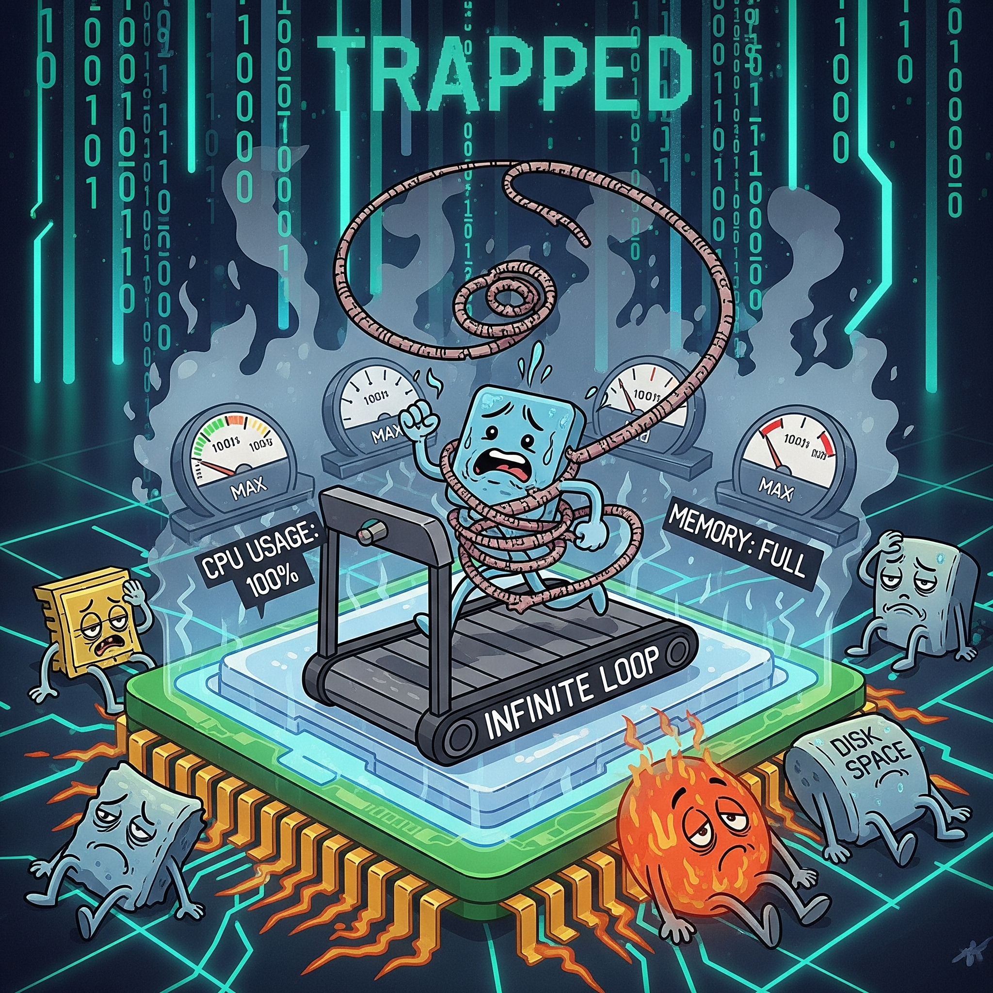
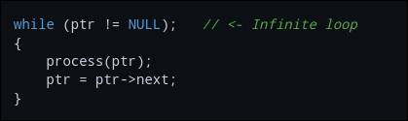
Problem Example – while loop
The semicolon creates an infinite empty loop.
The block { process(ptr); ... } is no longer part of the loop.
Impact:
The program hangs, leading to Denial of Service.
Wasted CPU cycles, resource exhaustion, and potential system crashes.

Slide 5

Problem Example – for loop
The semicolon ends the loop early.
The printf is not part of the loop body.
Loop runs empty → printf runs only once.
Code that should run for every item is skipped.
Critical operations (like validation or checks) may never run.

Slide 6
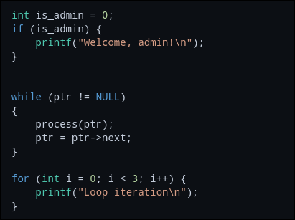
Correct Usage
Removing the semicolon properly controls the block.
Best practice: Always wrap blocks in braces {} – even if it’s a single statement.
This prevents ambiguity and makes code more maintainable.

Slide 7
Security Impact and Best Practices
Authentication bypass: a stray ; after an if statement can cause checks to be ignored.
Validation flaws: input checks may never execute.
DoS attacks: infinite loops can lead to service outages.
Silent vulnerabilities: code that appears correct often leads to overlooked issues by reviewers.
Attackers are aware of this pattern and actively seek it in open-source and legacy codebases.

Slide 8
Best Practices
Never place a ; after an if, for, or while statement.
Always use braces {} for safer and more readable code.
Enable compiler warnings:
gcc -Wall -Wextra can often detect "empty statements" after loops.
Static Analysis tools can automatically identify these issues.
Conduct code reviews: train yourself to identify "orphan semicolons.”

